Slide 1
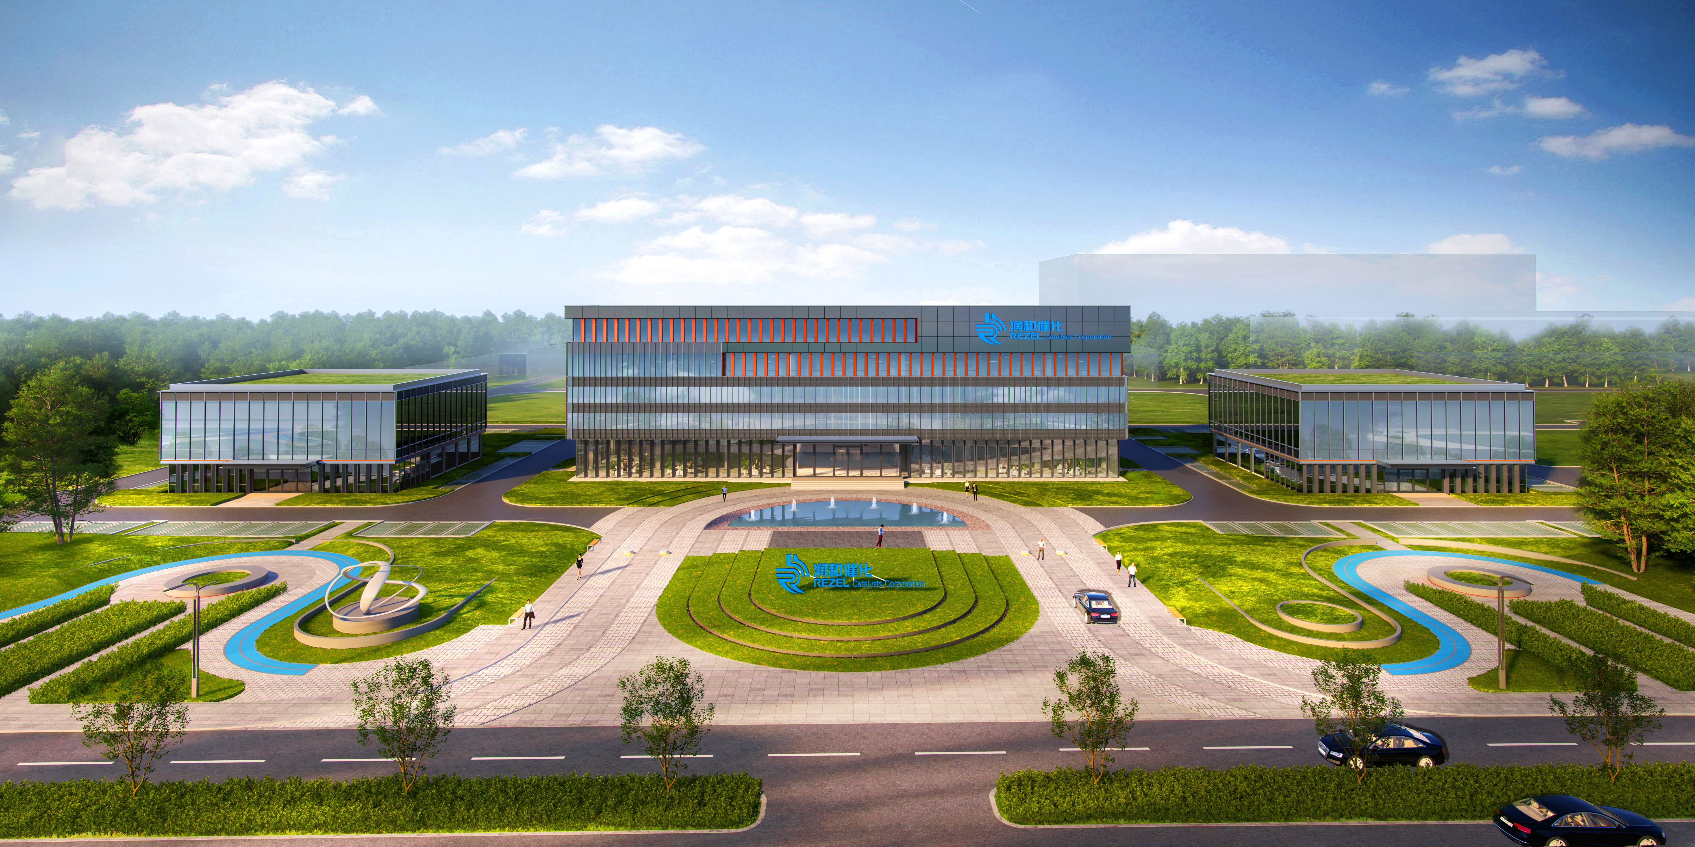
稀土在催化领域的应用：从工业化到前沿探索
Applications of Rare Earths in Catalysis: From Industrialization to Frontier Exploration
报告人：施宗波 博士 Presenter:Dr. Zongbo Shi
单位：润和催化剂股份有限公司 Affiliation:Runhe Catalysis Co., Ltd.
时间：2026年6月26日 | 地点：厦门 Info:June 26, 2026 | Xiamen

Slide 2
CONTENTS / 目录
01. 稀土催化概述
Overview of Rare Earth Catalysis
02. 工业化应用现状
Current Status of Industrial Applications
03. 潜在应用领域探索
Exploration of Potential Application Fields
04. 国内外最新研究进展
Latest Research Progress at Home and Abroad
05. 总结与未来展望
Conclusion and Future Outlook
Notes:
本次报告将分为六个部分。首先，我们会对稀土催化做一个整体的概述。接着，重点介绍其在汽车尾气净化、石油化工等领域的工业化应用现状。然后，我们将目光投向未来，探索其在CO2还原、光解水制氢等方面的潜在应用。之后，我们会分享一些国内外的最新研究进展，并深入分析其催化作用的机理。最后，对全文进行总结并展望未来的发展方向。

Slide 3
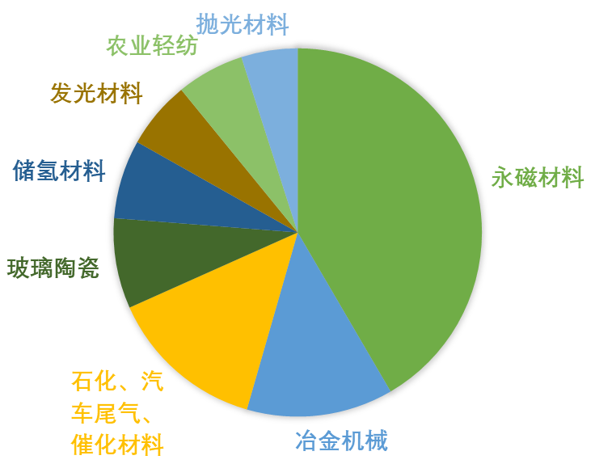
稀土催化概述 / Overview of Rare Earth Catalysis
核心定义 (Definition)
包含镧系元素(La-Lu)及钪(Sc)、钇(Y)，共17种元素。
Contains 17 elements, including the lanthanides (La–Lu), scandium (Sc), and yttrium (Y).
工业地位与市场 (Market)
• 全球规模：2024年估值31-52 亿美元，年复合增长率约为5.5-7.5 %¹。
Global market size: Valued at $3.1–5.2 billion in 2024, with a compound annual growth rate (CAGR) of approximately 5.5–7.5% ¹.
• 稀土年消耗量：2025年2.1万吨，石油裂化占比38%，汽车尾气占比29%，新能源占比18%²。
Annual rare earth consumption: 21,000 tonnes in 2025, with 38% used in petroleum cracking, 29% in automotive exhaust treatment, and 18% in new energy applications.
https://m.gepresearch.com/1190/view-855070-1.html (全球环保研究网)
https://www.gepresearch.com/80/view-781299-1.html (全球环保研究网)
https://www.huaon.com/search?word=%E7%A8%80%E5%9C%9F%E5%82%AC%E5%8C%96
Notes:
首先，让我们明确什么是稀土催化。稀土元素指的是元素周期表中镧系的15个元素加上钪和钇。从市场规模来看，稀土催化材料正迎来快速增长期。据预测，2025年全球市场规模将达到72亿至85亿美元，而中国作为最大的生产和消费国，市场规模在2024年已接近190亿元人民币。预计到2030年，随着环保和新能源领域需求的爆发，全球市场规模有望突破200亿美元，其中中国市场占比将超过40%。这些数据充分说明了稀土催化材料在全球经济和科技发展中的重要战略地位。

Slide 4
稀土元素的独特性质 / Unique Properties of Rare Earth Elements
独特的电子结构 (Electronic Structure)
可变的氧化价态 (Variable Valency)
拥有未充满的4f电子层，受外层5s²5p⁶电子有效屏蔽。这种独特的“黑匣子”结构赋予了稀土元素优异的光谱和磁学性质。
Possesses an unfilled 4f electron shell, effectively shielded by the outer 5s²5p⁶ electrons. This unique 'black box' structure endows rare earth elements with excellent spectral and magnetic properties.
除常见+3价外，铈、钐、铕等元素可形成+2或+4价态。这种价态的可变性使其在氧化还原反应中表现出卓越的催化活性。
In addition to the common +3 oxidation state, elements such as cerium, samarium, and europium can form +2 or +4 valence states. This variability in valency results in exceptional catalytic activity in redox reactions.
丰富的能级跃迁 (Energy Level Transition)
强的配位能力 (Coordination Ability)
4f电子层内存在众多相近能级，可吸收和发射从紫外到红外的光子，是高性能发光材料的核心基础。
Numerous closely spaced energy levels exist within the 4f electron shell, enabling absorption and emission of photons from the ultraviolet to the infrared. This is the core foundation for high-performance luminescent materials.
较大的离子半径和高正电荷使其能与多种配体形成稳定配合物，为其作为路易斯酸催化剂提供了理想的结构基础。
The large ionic radius and high positive charge allow them to form stable complexes with various ligands, providing an ideal structural basis for their role as Lewis acid catalysts.
Notes:
稀土催化剂之所以如此重要，根源在于稀土元素本身独特的物理化学性质。最核心的是它们拥有未充满的4f电子层，这个“内部电子层”被外层电子很好地保护起来，就像一个神秘的“黑匣子”，赋予了稀土元素许多神奇的特性。比如，它们能展现出丰富的颜色和发光性能，同时，这种电子结构也让它们容易发生价态变化，在化学反应中能够灵活地获得或失去电子，从而高效地催化反应的进行。

Slide 5
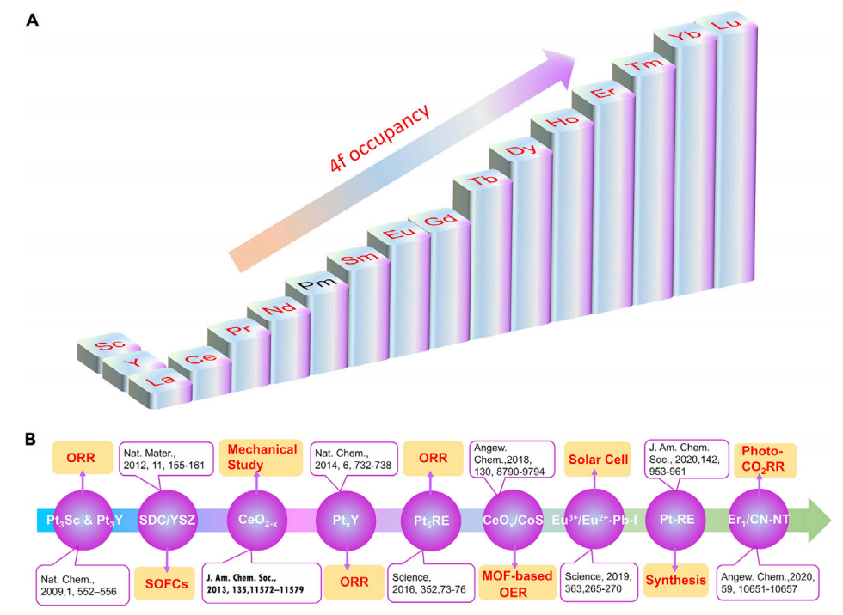

稀土元素特性和稀土基材料在催化方面的应用/
Characteristics of Rare Earth Elements and Their Catalytic Applications
1. 基质材料 Matrix Materials
2. 催化材料 Catalytic Materials
3. 发光材料 Luminescent Materials
4. 磁性材料 Magnetic Materials
5. 超导材料 Superconducting Materials
6. 铁电材料 Ferroelectric Materials
7. 压电材料 Piezoelectric Materials
8. 储放氧材料 Hydrogen Storage Materials
抛光材料 Hydrogen Storage Materials
10 ………
稀土在新能源领域的应用进展
Progress in the application of rare earths in the new energy field.

Slide 6
PART 02 / 第二部分
工业化应用现状
Current Status of Industrial Applications
Notes:
接下来，我们进入第二部分，详细了解稀土催化剂在工业界的成熟应用。这些技术已经深刻地融入了我们的现代工业体系，为节能减排和提高生产效率做出了巨大贡献。

Slide 7
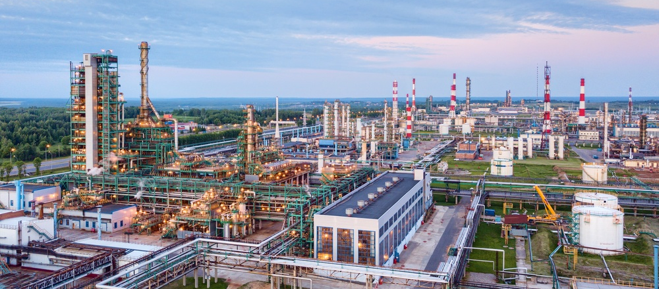
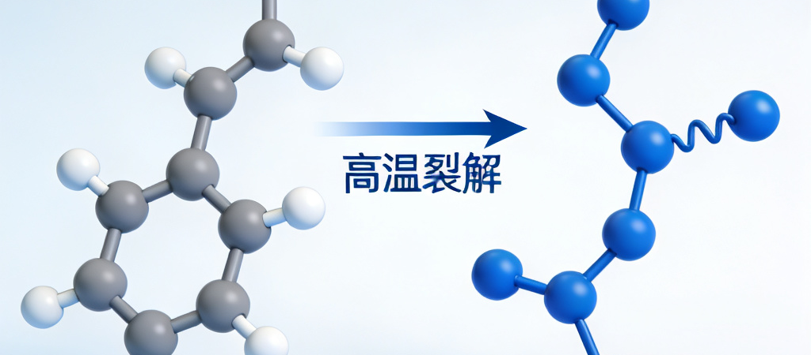
石油催化裂化 (FCC) / Fluid Catalytic Cracking
核心应用：稀土Y型分子筛Core Application: REY Zeolite
工作原理：La/Ce 改性增强
Working Principle: La/Ce Modification
经济效益：收率与节能双赢
Economic Benefits: Yield & Saving
稀土Y型分子筛（REY）是催化裂化工艺的核心。它能高效将重质油裂解为汽油、柴油等高附加值轻质油品。REY is the heart of the FCC process, efficiently cracking heavy oil into valuable light products like gasoline and diesel.
引入La和Ce显著提高了分子筛的酸性与热稳定性，增强了抗重金属中毒能力，确保在苛刻条件下长期高效运行。Adding La and Ce boosts the zeolite's acidity and thermal stability, making it more resistant to heavy metal poisoning.
轻质油收率提高约3.2%，年节约标煤超800万吨。稀土分子筛在全球FCC催化剂需求中占比超80%。Light oil yield ↑ ~3.2%, saving > 8M tons coal/year. Rare earth zeolites dominate >80% of FCC catalyst market demand.
现代化炼油厂全景：工业应用场景
Modern Refinery: The Key to Heavy Oil Upgrading
分子裂解示意图：重油大分子转化为轻质烃类
From Large Heavy Molecules to Light Hydrocarbons
Notes:
在石油化工领域，稀土同样扮演着关键角色。特别是在催化裂化过程中，稀土改性的分子筛催化剂能够“点石成金”，将价值较低的重质油高效转化为汽油、柴油等高附加值的轻质油品，极大地提升了炼油厂的经济效益。这背后，是稀土元素增强了催化剂的活性和稳定性，使其能够在苛刻的反应条件下长期高效工作。

Slide 8
石油裂解催化剂 - 稀土的作用/
Petroleum Cracking Catalysis - the functions of rare earth
改善了分子筛和基质的热稳定性
Improved the thermal stability of zeolite and matrix
调制了催化剂的酸性
Modulated the acidity of the catalyst
不同的稀土元素性能有差别
Different rare earth elements have different properties
稀土元素在催化剂颗粒中的位置不同，作用不同
The functions of rare earth elements at different positions are different
REO
捕集V
Capture
Metals
稳定分子筛
Stabilize
Zeolite
稳定基质
Stabilize
Matrix
调节活性位点
Modify
Acidity
减少氨氮排放
Reduce
Emissions

Slide 9
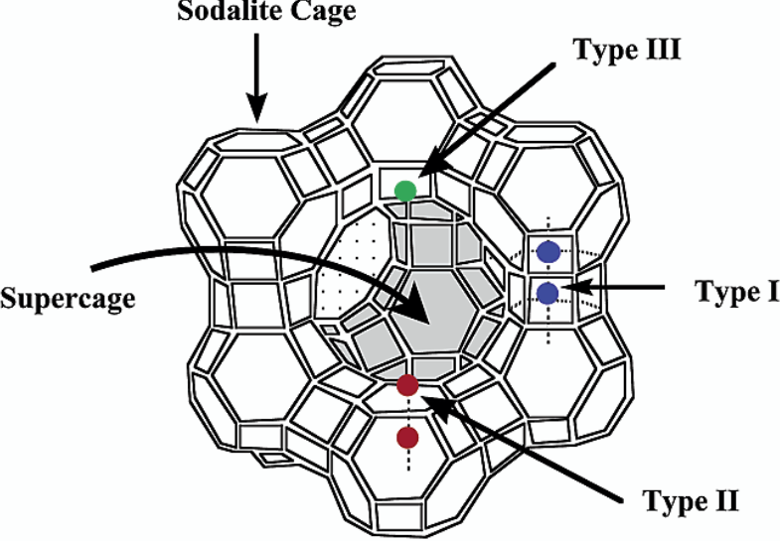
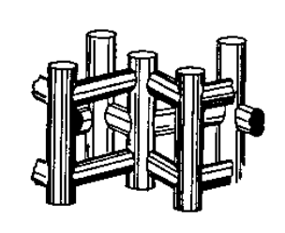
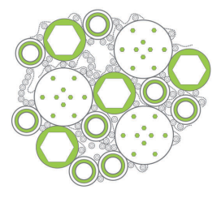
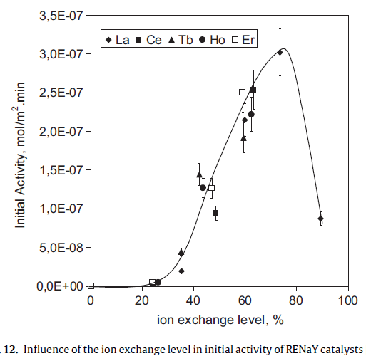

FCC催化剂中的稀土/ the rare earth in FCC catalysts
FCC 催化剂微球示意图
FCCCatalyst Microsphere
稀土在基质上Rare Earth on the Matrix
分子筛晶粒
zeolite
存在状态：氧化物簇 oxide clusters
位置： 表面上 on surface
作用： 金属钒吸附中心
absorbing V metal
基质
Matrix
ZeoliteY
ZSM-5
稀土在分子筛中Rare Earth in the Zeolite
存在状态：离子 ion
位置： 方钠石笼中 inside sodalite cage
与两个临近的骨架铝作用 interacting with two adjacent framework Al
作用： 稳定骨架铝-稳定酸中心
stabilizing framework Al
stabilizing acid sites
增加氢负离子转移
Enhanced hydride transfer
70 μm
离子交换水平对RENaY催化初始活性的影响

Slide 10
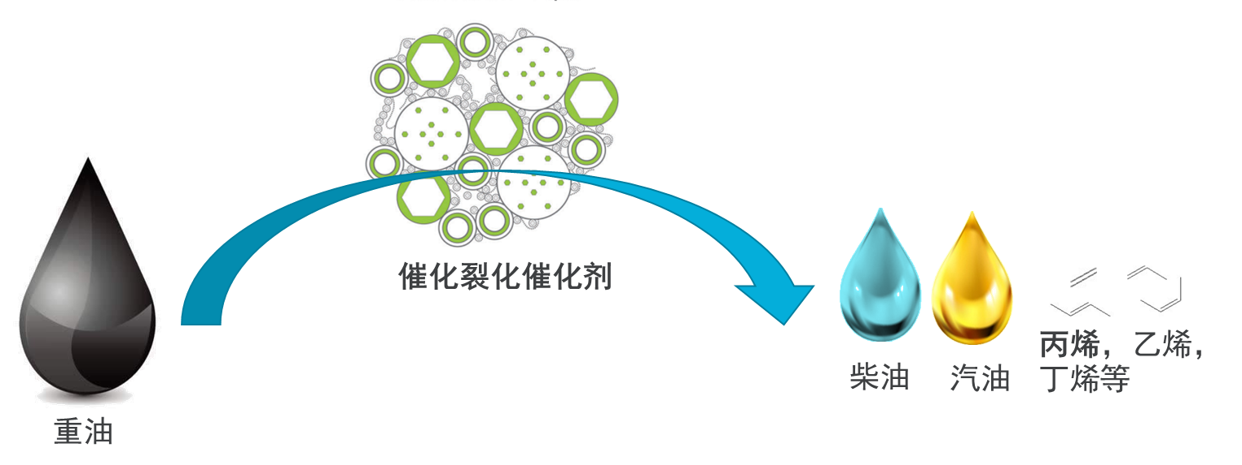
石油炼制催化剂应用/ Petroleum Cracking Catalysts Applications
REZEL FCC催化剂特点REZEL RFCC Catalyst Features
高活性和高稳定性High Activity & Stability
抗金属性能好High Metal Resistance
低碳烯烃收率高High Olefin Yield
Test Item (检测项目) | Reference (参考剂) | REZEL RFCC (润和)
Surface Area (m²/g) | 比表面积 | 255 | 313
Pore Volume (ml/g) | 孔体积 | 0.37 | 0.39
Bulk Density (g/ml) | 表观密度 | 0.72 | 0.74
Attrition Index (%) | 磨损指数 | 2.2 | 1.4
项目 Item | Reference (参考剂) | REZEL RFCC (润和)
转化率Con., wt% | 75.56 | 77.70
焦炭Coke, wt% | 12.94 | 12.53
干气Dry gas, wt% | 3.14 | 3.82
丙烯Propylene, wt% | 4.45 | 7.11
汽油 gasoline, wt% | 44.41 | 42.19
柴油LCO, wt% | 16.47 | 15.82
油浆bottoms, wt% | 7.97 | 6.48
液化气LPG, wt% | 15.07 | 19.17
汽油+液化气+柴油gasoline+LPG+LCO, wt% | 75.95 | 77.18

Slide 11
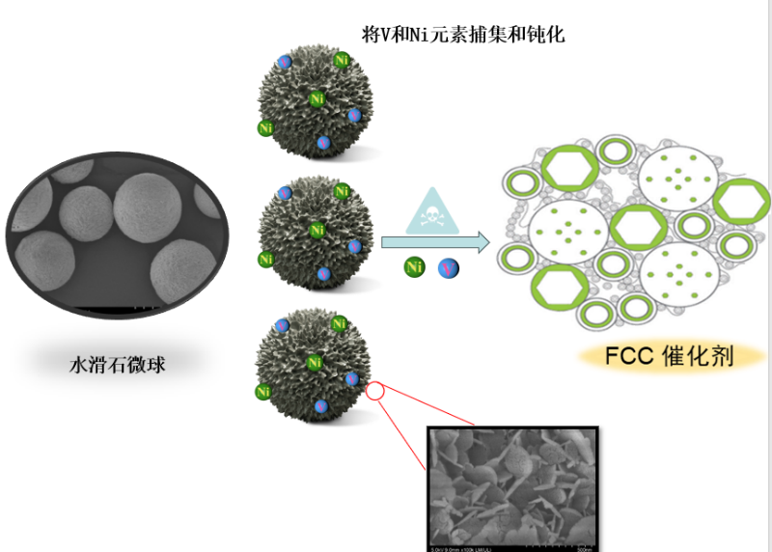
石油炼制催化剂应用/ Petroleum Cracking Catalysts Applications
应用目标 APPLICATION TARGET
专为处理高含量钒(V)、镍(Ni)和铁(Fe)等污染物的重质进料而设计。
Specifically designed for processing heavy feeds with high contaminant levels of Vanadium (V), Nickel (Ni), and Iron (Fe).
核心设计原则 CORE DESIGN PRINCIPLES
• 钝化：选择性中和V, Ni, Fe，减少脱氢和汽油烯烃。
Passivation: Selectively neutralizes V, Ni, Fe to reduce dehydrogenation and gasoline olefins.
• 纳米结构：Ni/Al/Ce/Ta基质促进金属的高效扩散。
Nano-Structure: Ni/Al/Ce/Ta matrix facilitates efficient diffusion of metal contaminants.
• 性能：降低平衡催化剂中的金属含量，显著提高催化剂活性和焦炭选择性。
Performance: Lowers metal content in E-Cat, improving catalyst activity & coke selectivity significantly.
项目 Item | 单位 unit | M-T-003 稀土氧化物微球rare earth oxide microspheres | M-T-004 Mg/Al/Ce微球 Mg/Al/Ce microspheres
0-20 micron | wt% | <3 | <3
0-40 micron | wt% | <40 | <18
D50 | Micron | 40-60 | 65-85
磨损指数Attrition Index | wt% | <10 | <3
Notes:
Location: China
Fresh Cat Add Rate: 2.5kg/MT of Feed

Slide 12
石油炼制催化剂应用/ Petroleum Cracking Catalysts Applications
催化剂转化率提高1~5% Conversion Rate Increase 1-5%。
高附加值的液化气+汽油+柴油的总收率提高1~2.5% Total yield increased by1-2.5%。
项目 Item | 0%钝化剂 0% metal trap | 5%参考钝化剂 5% reference metal trap | 5%Mg/Al/Ce微球 5% Mg/Al/Ce metal trap | 5%稀土氧化物微球 5% rare earth oxide metal trap
转化率Con., wt% | 79.12 | 81.58 | 85.72 | 85.25
焦炭Coke, wt% | 10.47 | 10.45 | 10.06 | 10.23
干气Dry gas, wt% | 3.68 | 3.51 | 4.00 | 3.97
汽油 gasoline, wt% | 45.98 | 47.61 | 47.61 | 47.12
柴油LCO, wt% | 14.93 | 13.39 | 10.58 | 10.92
油浆bottoms, wt% | 5.95 | 5.03 | 3.70 | 3.83
液化气LPG, wt% | 18.99 | 20.01 | 24.05 | 23.93
汽油+液化气+柴油gasoline+LPG+LCO, wt% | 79.90 | 81.01 | 82.24 | 81.97

Slide 13

稀土在丙烷脱氢(PDH)领域的应用/
Application of Rare Earths in Propane Dehydrogenation (PDH)
丙烷
Propane
丙烯
Propylene
氢气H₂
核心作用：关键助剂 Core Role: Key Promoter
稀土元素（如镧La、铈Ce）主要作为助剂添加到铂（Pt）基或铬（Cr）基催化剂中，优化催化性能。Rare earths (La, Ce) are added as promoters to Pt or Cr-based catalysts to optimize the overall catalytic performance.
主要优势Main Advantages
提升稳定性：抑制活性金属烧结和积碳失活，延长寿命。
Enhanced Stability:Inhibits metal sintering and coking, significantly extending the service life of the catalyst.
增强活性与选择性：调变电子结构和酸性位点，提高转化率。
Activity & Selectivity:Modulates electronic structure and acidic sites to achieve higher propylene conversion efficiency.
改善抗积碳能力：利用储氧能力促进积碳前驱体氧化消除。
Improvement of anti-coking performance: Utilizing oxygen storage capacity to promote the oxidation and elimination of coke precursors.
应用现状Application Status
主流技术（如Oleflex、Catofin）均可引入稀土助剂，实现高效稳定的丙烯生产。Mainstream industrial technologies (e.g., Oleflex & Catofin) widely incorporate rare earth promoters for efficient and stable propylene production.
Notes:
在重要的化工原料丙烯的生产中，丙烷脱氢（PDH）技术扮演着越来越关键的角色。稀土元素在这一领域同样发挥着不可替代的作用。它们主要作为助剂被添加到铂基或铬基催化剂中，能够有效提升催化剂的稳定性，防止其在高温反应中失活，同时还能提高反应的活性和选择性，帮助我们更高效地生产丙烯。目前，全球主流的PDH技术都离不开稀土的贡献。

Slide 14
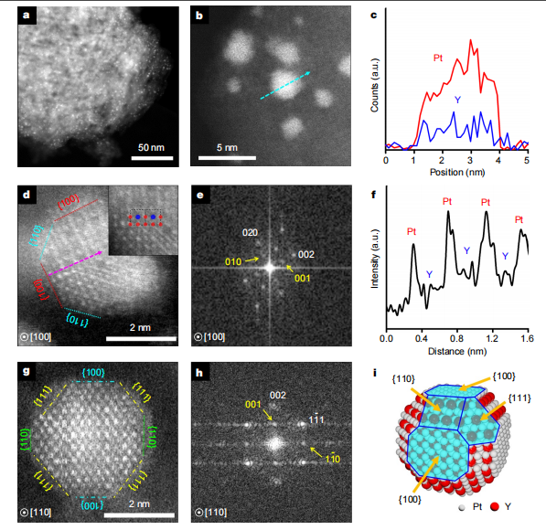
丙烷脱氢应用/ Propane dehydrogenation application Pt₃RE-mz-deGa
硅酸镓ZSM-5
Gallium Silicate ZSM-5
Si
O
H
脱镓产生结构缺陷
Degallation creates structural defects (Si-OH)
Si-OH HO-Si
H
O
Si
浸渍Pt和稀土
Impregnate with Platinum (Pt) and Rare Earth (RE)
还原产生Pt₃RE-mz-deGa
Reduction produces active catalyst:Pt3RE-mz-deGa
R. Ryoo, et al. Nature， vol 585，10 September 2020， 221-225

Slide 15
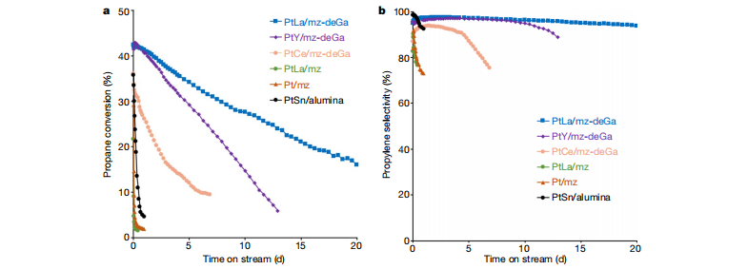
丙烷脱氢应用/ Propane dehydrogenation application Pt₃RE-mz-deGa
含稀土的新型催化剂相比其前身，展现出了显著优化的催化性能，核心优势体现在两个方面：
TheRE-containing catalystdemonstrates significantly improved properties compared to its predecessors:
●卓越的稳定性：在长时间连续运行过程中，能够始终保持高催化活性，避免了快速失活的问题。
•Superior Stability:Maintains high activity over extended time on stream without rapid deactivation.
●极高的选择性：持续稳定地生产目标产物丙烯，同时将副产物的生成量控制在极低水平。
•High Selectivity:Consistently produces propylene with minimal by-product formation.
R. Ryoo, et al. Nature， vol 585，10 September 2020， 221-225

Slide 16
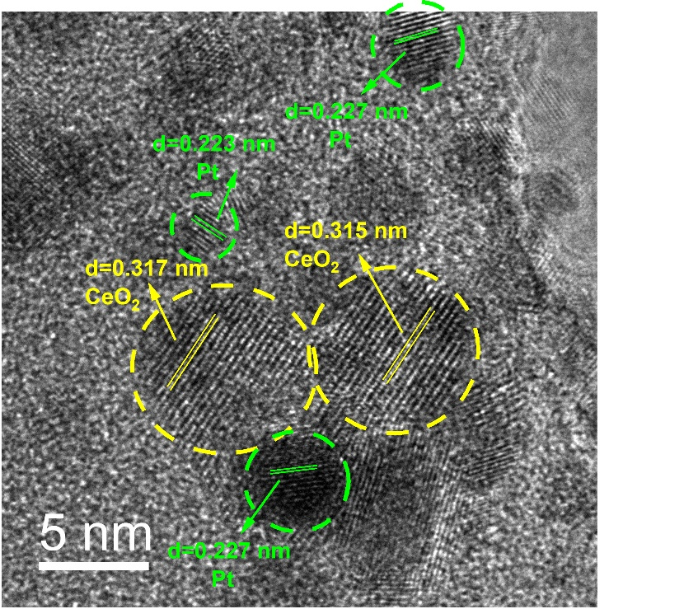
丙烷脱氢应用/ Propane dehydrogenation application PtCe/Mn-S-1
CeO_{x}中形成的氧空位与Pt协同作用，提高反应转化率和选择性The oxygen vacancies formed in CeOₓ synergize with Pt to enhance reaction conversion and selectivity.
0.5Pt0.2Ce/Mn-S-1实现丙烷转化率38%，丙烯选择性88%0.5Pt0.2Ce/Mn‑S‑1 achieves a propane conversion of 38% and a propylene selectivity of 88%.
CeO_{x} 对Pt有强亲和力，与Pt之间电子相互作用抑制Pt的迁移； CeO_{x} exhibits a strong affinity for Pt, and the electronic interaction with Pt suppresses the migration of Pt species.
释放的晶格氧能促进积碳分解，提高催化剂稳定性。 The released lattice oxygen can promote the decomposition of carbon deposits, thereby improving the stability of the catalyst.
CeO_{x}
DOI:10.1002/cctc.202501173

Slide 17
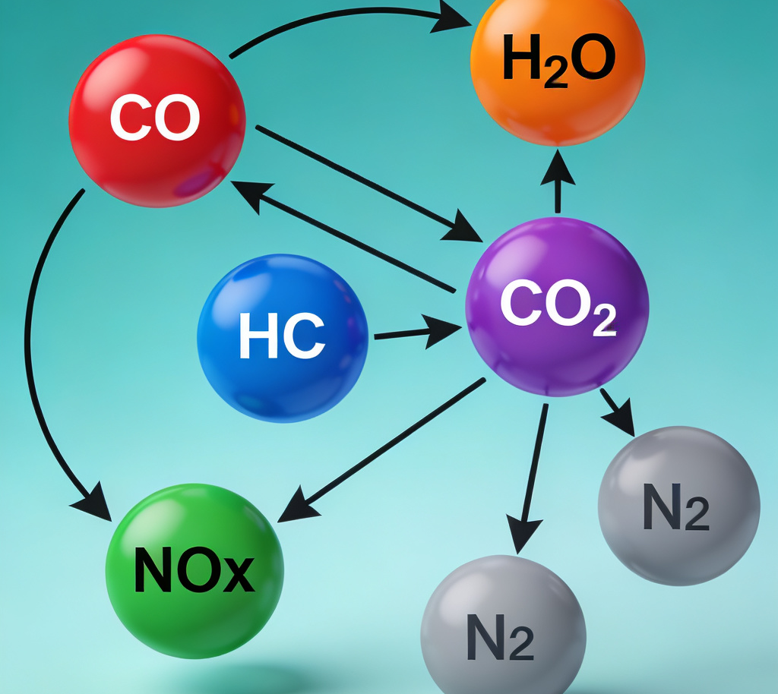
汽车尾气净化 / Automotive Exhaust Purification
核心技术：三效催化剂 (TWC)
Core Technology: Three-Way Catalyst (TWC)
以铈基储氧材料（如CeO₂-ZrO₂）为关键组分，是汽车尾气净化的核心，能实现高效的氧化还原反应。Using cerium-based oxygen storage materials (such as CeO₂-ZrO₂) as key components, it is the core of automotive exhaust purification and enables efficient redox reactions.
动态氧缓冲：Ce3+/Ce4+ 循环机制
Dynamic Oxygen Buffering: Ce³⁺/Ce⁴⁺ Redox Cycle
动态储存和释放氧气，高效将CO、HC氧化为CO₂和H₂O，并将NOx还原为N₂，适应不同空燃比工况。
It dynamically stores and releases oxygen, efficiently oxidizing CO and HC into CO₂ and H₂O while reducing NOₓ to N₂, adapting to various air-fuel ratio operating conditions.
市场主导：满足国六/欧六标准
Market Leadership: Meeting China 6 / Euro 6 Emission Standards
尾气分子催化分解示意图
转化效率超98%，是稀土催化剂最大应用市场（占比61.3%），是应对严苛排放标准的必备技术。With a conversion efficiency exceeding 98%, it represents the largest application market for rare earth catalysts (accounting for 61.3%), serving as an essential technology for complying with stringent emission regulations.
Notes:
稀土催化剂最广为人知的应用就是汽车尾气净化。我们汽车里的三元催化器，其核心就是含有铈的储氧材料。
它能像一个“氧气缓冲池”，在发动机工况变化时，动态调节氧气量，从而同时高效处理尾气中的三种主要污染物：一氧化碳、碳氢化合物和氮氧化物，将它们转化为无害的二氧化碳、水和氮气，为我们的蓝天保卫战立下汗马功劳。

Slide 18
环境保护催化剂/ Environmental Protection Catalysts
三效催化剂使用铈锆固溶体载体 (同时处理HC， CO 和NO_{X}）
Three-way catalysts employ ceria-zirconia solid solution supports for the simultaneous removal of HC, CO and NOₓ.
存在的问题Issues:
  铈锆固溶体载体不稳定Carrier is not stable
需求Requirement：
  良好的热稳定性 Good thermal stability
  高的OSC能力High OSC capability
润和方法：
  多组分稀土复合氧化物固溶体 A_{x}B_{y}C_{z}D_{w}O_{3/2(x+y+z+w)} Multicomponent rare earth oxide solid solution
  水热合成方法 hydrothermal synthesis
  添加模板剂造孔 Add template for porosity

Slide 19
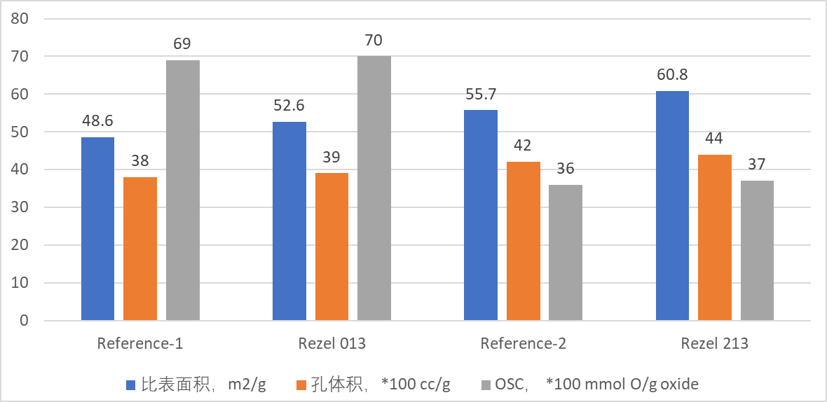
高热稳定性稀土混合氧化物/ High thermal stability rare-earth mixed oxides
与参考样品相比，REZEL的稀土混合氧化物固溶体热稳定性更好，同时OSC性能保持。
Compared to the reference sample, REZEL rare earth mixed oxide solid solution exhibits better thermal stability while maintaining its OSC performance.
Item | Name | Metal Oxide wt% |  |  |  |  | 1000°C/4h
 |  | CeO₂ | ZrO₂ | La₂O₃ | RE-A | RE-B | BET surface area，m²/g | Pore volume，cc/g | OSC， mmol O/g oxide
高Ce铈锆固溶体High-Ce ceria‑zirconia oxide | Reference | 40 | 50 | 5 | 5 | 0 | 48.6 | 0.38 | 0.69
 | Rezel 013 | 40 | 50 | 5 | 5 | 0 | 52.6 | 0.39 | 0.7
低Ce铈锆固溶体 Low-Ce ceria‑zirconia oxide | Reference | 24 | 60 | 3.5 | 0 | 12.5 | 55.7 | 0.42 | 0.36
 | Rezel 213 | 24 | 60 | 3.5 | 0 | 12.5 | 60.8 | 0.44 | 0.37

Slide 20
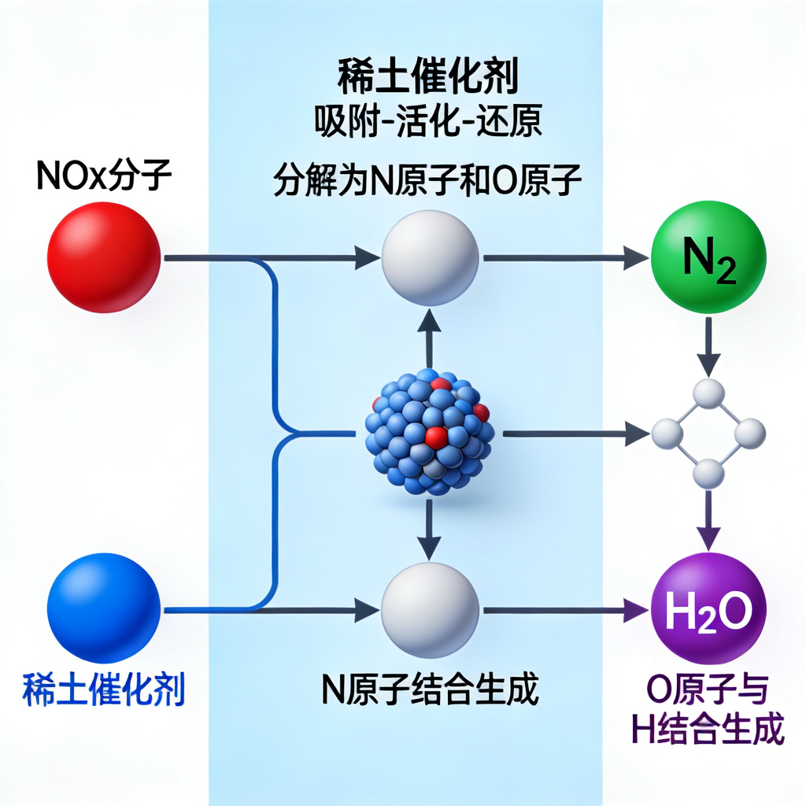
工业废气脱硝 (SCR) / Industrial Flue Gas Denitrification
核心应用场景 Core Application Scenarios
广泛应用于火力发电、钢铁、水泥等高污染行业，利用稀土基SCR催化剂高效去除烟气中的氮氧化物(NOx)。Widely used in high-pollution industries such as thermal power generation, steel, and cement. Rare earth-based SCR catalysts are adopted to efficiently remove nitrogen oxides (NOₓ) from flue gas.
卓越技术优势Outstanding Technical Advantages
相比传统钒钛基催化剂，稀土催化剂具有更宽的活性温窗(250-400℃)和优异的抗硫中毒能力，NOx转化率超85%。Compared with traditional vanadium-titanium-based catalysts, rare earth catalysts feature a wider active temperature window (250–400℃) and excellent sulfur poisoning resistance, with NOₓ conversion rate exceeding 85%.
广阔市场前景Broad Market Prospects
环保法规趋严推动市场增长，预计2032年全球稀土脱硝催化剂市场规模将达约14.84亿美元¹。Stricter environmental regulations drive market growth. The global market size of rare earth denitrification catalysts is projected to reach approximately 1.484 billion US dollars by 2032.
1. https://m.gelonghui.com/p/4051387
Notes:
除了汽车，稀土催化剂在更大型的工业废气治理中也发挥着关键作用。在电厂、钢铁厂，稀土基的脱硝催化剂能有效去除燃烧烟气中的氮氧化物，这是造成酸雨和光化学烟雾的主要元凶。稀土催化剂凭借其宽温区、高活性的特点，成为工业脱硝的主力军，为工业绿色转型提供了有力支撑。

Slide 21
PART 03 / 第三部分
潜在应用领域探索
Exploration of Potential Application Fields
Notes:
看完了成熟的工业应用，现在让我们将目光投向未来，探索稀土催化在一些前沿领域的巨大潜力。这些方向不仅代表着科学研究的最前沿，也为解决全球能源和环境挑战提供了新的思路。

Slide 22
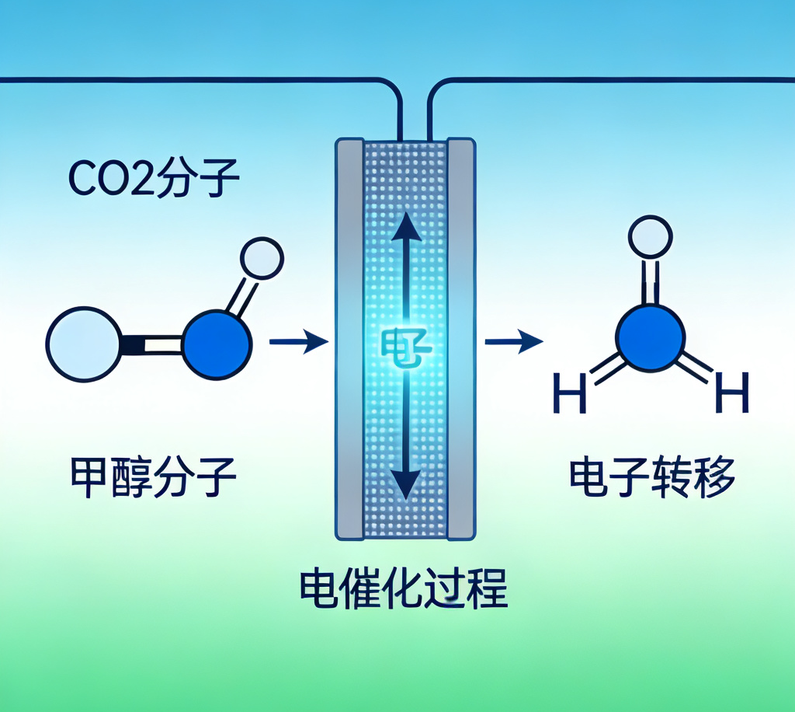
CO₂电催化还原 / Electrochemical CO₂ Reduction
研究前沿：变废为宝Research Frontier: Turning Waste into Treasure
将温室气体CO₂转化为甲醇、乙醇等高附加值化学品，是实现“碳中和”的关键路径，稀土元素在此过程中发挥着核心调控作用。Converting greenhouse gas CO₂ into high-value chemicals such as methanol and ethanol is a key pathway to achieving "carbon neutrality", in which rare earth elements play a core regulatory role.
最新成果：稀土调控Latest Achievement: Rare Earth Modulation
利用稀土元素镨（Pr）调控铜基催化剂电子结构，成功构建动态自修复催化界面，显著提升了反应稳定性与活性。Rare earth element praseodymium (Pr) is used to modulate the electronic structure of copper-based catalysts, successfully constructing a dynamically self-healing catalytic interface that significantly improves reaction stability and activity.
性能突破：工业级潜力Performance Breakthrough: Industrial-Grade Potential
在700 mA/cm²工业级电流密度下，多碳醇选择性达71.3%，展现了从实验室走向工业化应用的巨大潜力。At an industrial-level current density of 700 mA/cm², the selectivity to multi-carbon alcohols reaches 71.3%, demonstrating great potential for translating from laboratory research to industrial applications.
Notes:
在应对气候变化的大背景下，如何将二氧化碳变废为宝是科学界的一大热点。稀土元素在这里找到了新的舞台。研究人员发现，通过稀土元素的巧妙调控，可以显著提高二氧化碳电催化还原的效率和对目标产物（如乙醇）的选择性。这为我们利用可再生电能，将温室气体直接转化为液体燃料提供了一条极具前景的技术路线。

Slide 23
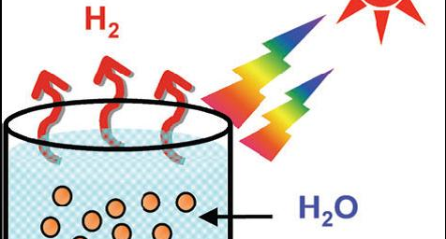
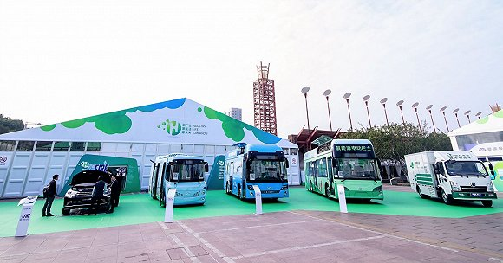
光催化分解水制氢 / Photocatalytic Water Splitting
研究前沿与策略 Research Frontiers and Strategies
改性技术突破 Modification Technology Breakthrough
关键性能指标 Key Performance Indicators
利用太阳能光催化分解水是获取绿色氢能的理想方式。稀土元素的掺杂策略为开发高效光催化剂提供了新的突破方向。 Solar-driven photocatalytic water splitting is an ideal way to produce green hydrogen. Rare earth element doping strategies provide new breakthrough directions for developing high-efficiency photocatalysts.
中科院金属所团队利用稀土元素钪（Sc）对传统二氧化钛进行改性，成功优化了催化剂的电子结构，显著提升了性能¹。 The team at the Institute of Metal Research, Chinese Academy of Sciences, modified conventional titanium dioxide with the rare earth element scandium (Sc), successfully optimizing the electronic structure of the catalyst and significantly improving its performance¹.
光生电荷分离效率提升200多倍，模拟太阳光下产氢效率提升15倍，为技术实用化奠定基础。 The photogenerated charge separation efficiency is increased by over 200 times, and the hydrogen production efficiency under simulated sunlight is improved by 15 times, laying the foundation for practical application of the technology.
图1：光催化分解水原理示意Figure 1: Schematic diagram of photocatalytic water splitting principle
图2：氢能应用前景（氢能汽车）Figure 2: Prospects of hydrogen energy applications (hydrogen-powered vehicles)
1. J Am Chem Soc. 2025 Apr 16;147(15):12897-12907
Notes:
氢能被视为未来的终极能源之一。如何高效、低成本地制取氢气是关键。稀土元素再次展现了其价值。通过在光催化剂中掺杂稀土，科学家们成功地大幅提升了光解水制氢的效率。这意味着我们可以更有效地利用太阳能来生产清洁的氢气，为未来的氢能社会提供了强大的技术支持。

Slide 24

稀土基电催化剂 / Rare Earth-Based Electrocatalysts
研究前沿：清洁能源核心反应Research Frontier: Core Reactions for Clean Energy
稀土元素在HER、OER和ORR反应中展现巨大潜力，是电解水制氢和燃料电池技术的关键。Rare earth elements show great potential in HER, OER, and ORR reactions, and are key to water electrolysis for hydrogen production and fuel cell technologies.
最新成果：高性能非贵金属催化剂 Latest Achievement: High-Performance Non-Noble Metal Catalysts
开发出稀土掺杂的过渡金属硫族化合物，在OER中活性媲美贵金属IrO₂，大幅降低成本。 Rare-earth-doped transition metal chalcogenides have been developed, whose activity in OER is comparable to that of the noble metal IrO₂, significantly reducing costs.
理论与应用：机制解析与设计指导 Theory and Application: Mechanism Elucidation and Design Guidance
结合表征技术与理论计算，深入理解稀土调控机制，为下一代高效电催化剂提供设计蓝图。 Combining characterization techniques with theoretical calculations, the rare earth modulation mechanism is deeply understood, providing a design blueprint for next-generation high-efficiency electrocatalysts.
Notes:
在能源转换的电催化领域，稀土也成为了研究的新宠。无论是电解水制氢，还是燃料电池中的反应，科学家们都发现，通过引入稀土元素，可以显著提升电催化剂的性能。这不仅有助于我们摆脱对昂贵贵金属催化剂的依赖，还能大幅提高能源转换效率，为推动氢能经济和可再生能源的发展提供了新的技术路径。

Slide 25

有机合成催化 / Catalysis in Organic Synthesis
核心应用：路易斯酸催化Core Application: Lewis Acid Catalysis
作为重要的路易斯酸催化剂，广泛应用于环加成、聚合及不对称合成反应，构建复杂分子骨架。As important Lewis acid catalysts, they are widely used in cycloaddition, polymerization, and asymmetric synthesis reactions to construct complex molecular skeletons.
技术优势：高活性与高选择性 Technical Advantages: High Activity and Selectivity
具备高催化活性与良好的官能团耐受性，是合成医药、农药、香料等精细化学品的关键工具。 With high catalytic activity and good functional group tolerance, they are key tools for synthesizing fine chemicals such as pharmaceuticals, agrochemicals, and fragrances.
研究热点：手性配合物设计 Research Hotspot: Chiral Complex Design
致力于手性稀土配合物的设计，实现高对映选择性，为手性药物的合成提供高效绿色的新方法。 Focused on the design of chiral rare-earth complexes to achieve high enantioselectivity, providing efficient and green new methods for the synthesis of chiral drugs.
Notes:
在精细化工和制药领域，稀土催化剂同样大有用武之地。它们作为高效的路易斯酸，能够精准地催化各种有机反应，帮助化学家们构建复杂的分子结构。特别是在合成具有特定手性的药物分子时，稀土催化剂展现出卓越的选择性，为开发高效、低毒的新药提供了强有力的技术支持。

Slide 26
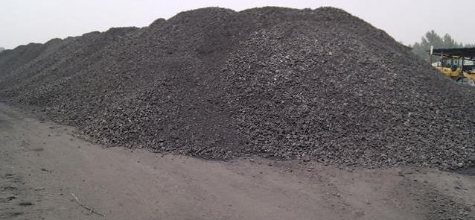
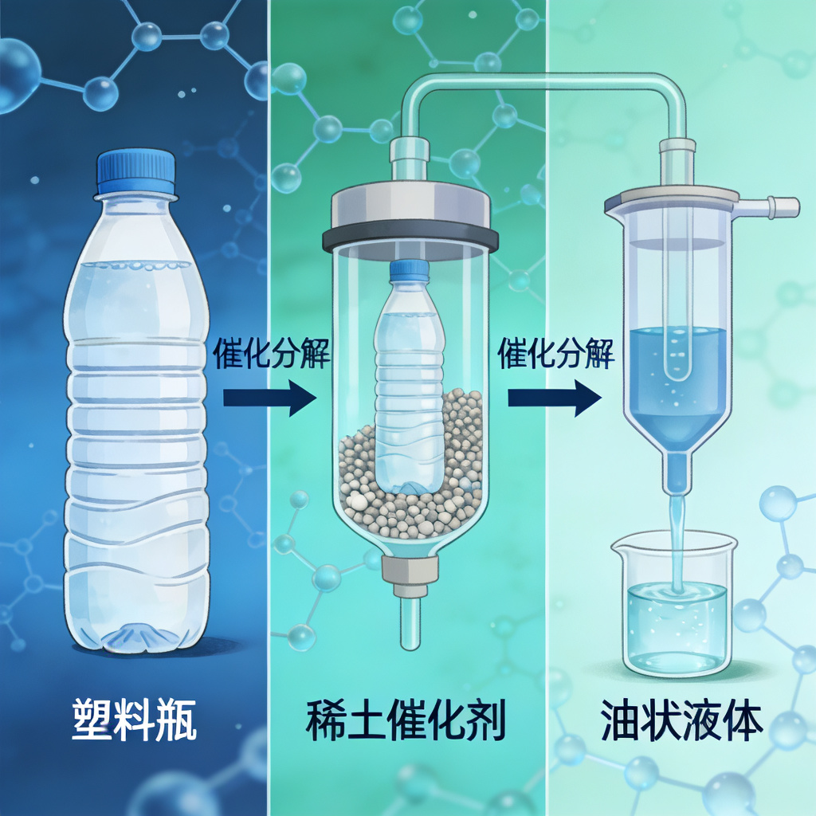

固废资源化利用 / Solid Waste Valorization
煤矸石制氢：变废为宝Hydrogen Production from Coal Gangue: Turning Waste into Treasure
利用镧、铈、镨改性双载体催化剂，将煤炭开采固废高效转化为富氢合成气，显著提升氢气产率，实现资源再生。Using La-, Ce-, and Pr-modified dual-support catalysts, coal mining solid waste is efficiently converted into hydrogen-rich syngas, significantly improving hydrogen yield and enabling resource regeneration.
塑料催化裂解：高值化回收 Catalytic Cracking of Plastics: High-Value Recycling
稀土掺杂催化剂降低裂解温度，大幅提高油品收率，为塑料垃圾的化学回收提供了清洁、高效的新路径。 Rare earth-doped catalysts lower the cracking temperature and greatly increase oil yield, providing a clean and efficient new pathway for the chemical recycling of plastic waste.
Ce⁴⁺ + e⁻ ⇌ Ce³⁺
Ag⁺ + e⁻ ⇌ Ag
PtCl₆²⁻ + 2e⁻ ⇌ Pt + 6Cl⁻
环境与经济效益双赢 Win-Win of Environmental and Economic Benefits
解决固废污染，生产高价值能源，助力“无废城市”与循环经济发展。 Solving solid waste pollution while producing high-value energy, supporting the development of "zero-waste cities" and the circular economy.
Notes:
稀土催化的应用还延伸到了固废处理这一民生领域。无论是堆积如山的煤矸石，还是无处不在的塑料垃圾，都可以在稀土催化剂的帮助下，转化为有用的氢气或燃料油。这不仅解决了环境污染问题，还创造了新的经济价值，真正实现了“垃圾是放错地方的资源”。

Slide 27
PART 04 / 第四部分
国内外最新研究进展 / Latest Research Progress
Notes:
接下来，我们将聚焦于科研最前沿，看看国内外的科学家们在稀土催化领域取得了哪些令人振奋的最新进展。这些研究不仅深化了我们对催化过程的理解，也为开发下一代高性能催化剂奠定了基础。

Slide 28
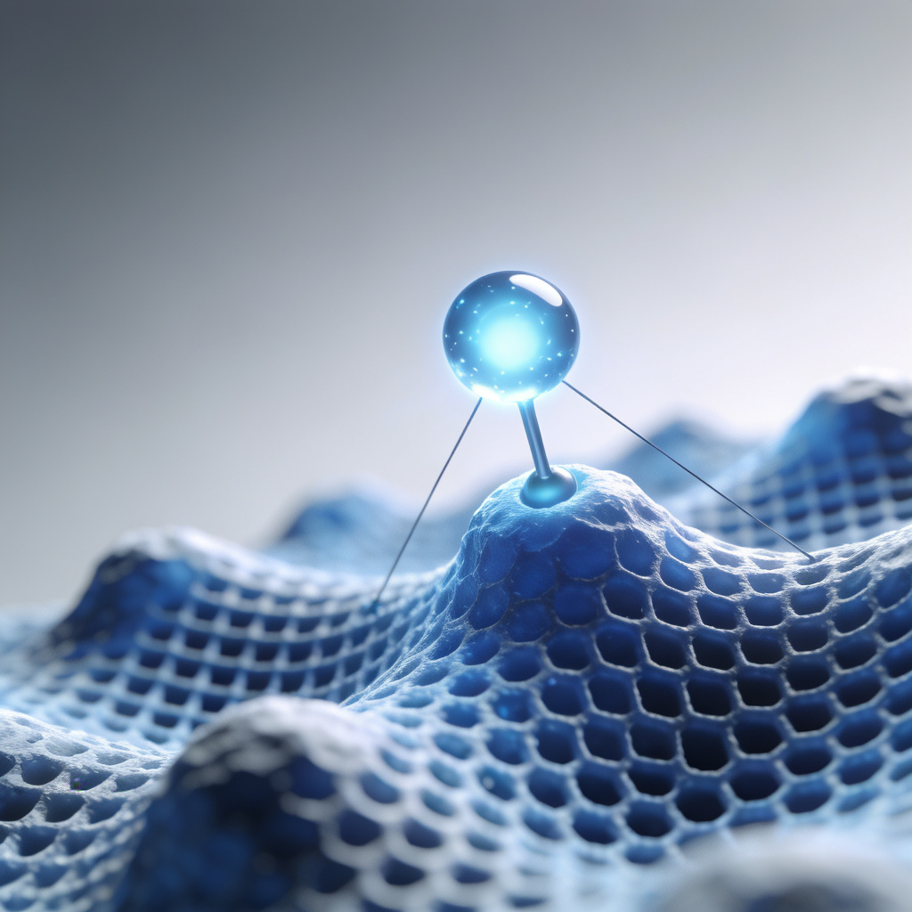
稀土单原子催化剂 / Rare Earth Single-Atom Catalysts
前沿方向：催化领域的“圣杯” Frontier Direction: The "Holy Grail" in Catalysis
单原子催化旨在将原子利用率提升至100%，稀土单原子催化剂是这一领域的新兴前沿方向。Single-atom catalysis aims to boost atomic utilization to 100%, and rare-earth single-atom catalysts represent an emerging frontier in this field.
核心优势：独特的电子几何结构Core Advantage: Unique Electronic and Geometric Structure
稀土原子以单原子形式锚定，不仅利用率高，还能产生独特的电子效应，带来意想不到的催化性能。Rare-earth atoms anchored in the form of single atoms achieve not only ultrahigh utilization but also unique electronic effects, leading to exceptional catalytic performance.
调控机制：电子转移与缺陷工程Regulation Mechanism: Electron Transfer and Defect Engineering
作为电子转移桥梁，调控载体缺陷与吸附位点，显著提升CO2还原等反应的活性和选择性。Acting as electron transfer bridges, they modulate support defects and adsorption sites, significantly enhancing the activity and selectivity of reactions such as CO₂ reduction.
Notes:
在催化研究的最前沿，科学家们正在尝试将稀土元素以单个原子的形式分散在载体上，这就是稀土单原子催化剂。这种方法能让每一个稀土原子都成为催化活性中心，实现原子利用率的最大化。更重要的是，这种独特的结构能带来全新的催化性能，为设计高效、经济的催化剂开辟了新的道路。

Slide 29
含稀土的单原子位点催化剂的合成方法及应用 /
The synthesis methods and applications of REM-containing SASCs
Catalysts | Rare earth compounds | Synthetic methods | Application | Year
Pt/CeO₂ | CeO₂ | Wet chemical methods, leached | Water-gas shift reactions | 2003
Au/CeO₂ | CeO₂ | Wet chemical methods, leached | Water-gas shift reactions | 2003
CeO₂–Pt/La–Al₂O₃ | CeO₂, La | Atoms trapping | CO oxidation | 2009
Pt/CeO₂ | CeO₂ | Atomic layer deposition | CO oxidation | 2017
Pt/CeO₂ | CeO₂ | Hydrothermal treatment | CO oxidation and diesel oxidation catalytic reaction | 2017
Rh/CeO₂ | CeO₂ | Hydrothermal treatment | Diesel oxidation catalytic reaction | 2018
Pt/CeO₂ | CeO₂ | Wet chemical methods | CO₂ electro-reduction | 2018
Pt/CeO₂ | CeO₂ | Atomic layer deposition | Dehydrogenation of ammonia borane | 2019
Er₁/CN-NT | Er | ACC | CO₂ photo-reduction | 2020
Ce–MnO₂ | CeO₂ | ion-exchange approach | NH₃-SCR | 2020
Ningqiang Zhang, HanYan, Lingcong Li, RuiWu, Liyun Song, Guizhen Zhang, Wenjun Liang, Hong He
Journal of Rare Earths, 39, 2021, 233-242

Slide 30
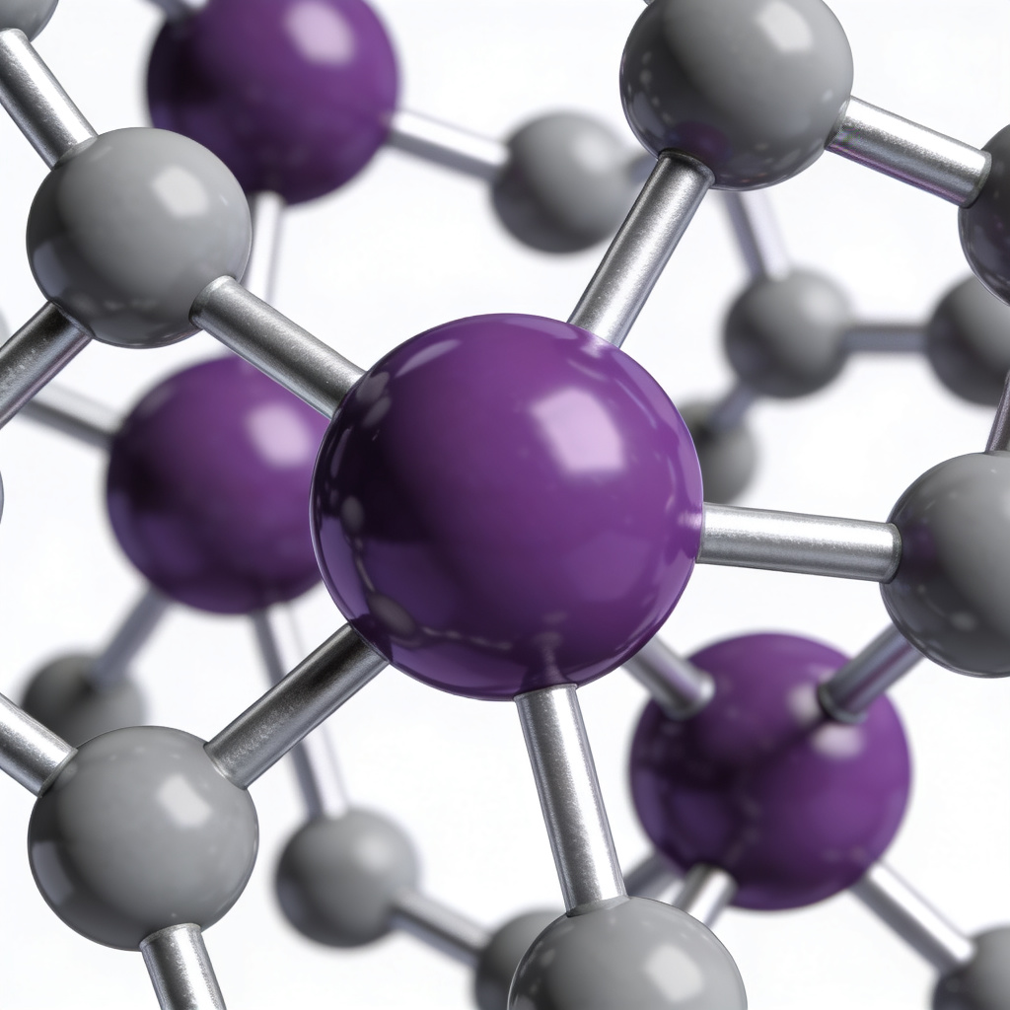
稀土配位工程 / Rare Earth Coordination Engineering
研究前沿：精细环境调控
Research Frontier: Fine Environmental Tuning
最新成果：ORR性能突破
Latest Achievement: ORR Performance Breakthrough
理论支撑：构效关系解析
Theoretical Support: Structure-Activity Relationship Analysis
通过改变配体种类与结构，为稀土离子“量体裁衣”，精确调控其电子结构，从而改变催化行为，实现高性能定制。By tailoring the type and structure of ligands to rare-earth ions, their electronic structure can be precisely modulated, altering catalytic behavior and enabling high-performance customization.
引入镧/铈构建Pdδ−-La/Ceδ+活性位点，利用配位极化效应，半波电位高达0.903 V，性能显著优于商业铂碳催化剂。Introducing lanthanum/cerium to construct Pdδ⁻-La/Ceδ⁺ active sites. Leveraging the coordination polarization effect, the half-wave potential reaches as high as 0.903 V, significantly outperforming commercial Pt/C catalysts.
结合原位表征与DFT计算，深入理解配位环境与催化性能的构效关系，为新型催化剂的理性设计提供坚实理论指导。 Combining in-situ characterization with DFT calculations, the structure-activity relationship between coordination environment and catalytic performance is thoroughly elucidated, providing solid theoretical guidance for the rational design of new catalysts.
配位结构模型示意图Schematic Diagram of Coordination Structure Model
图示为稀土离子与配体形成的稳定配位结构3D模型。中心紫色球体代表稀土离子，周围的灰色球体及连接键展示了配体如何通过配位键与中心离子结合，形成特定的空间构型。这种结构的精确控制是实现高性能催化的关键。The figure shows a 3D model of the stable coordination structure formed by rare-earth ions and ligands. The central purple sphere represents the rare-earth ion, and the surrounding gray spheres along with the connecting bonds illustrate how ligands bind to the central ion through coordination bonds to form a specific spatial configuration. Precise control of this structure is the key to achieving high-performance catalysis.
Notes:
另一个前沿方向是稀土配位工程。这就像是为稀土离子量身定制一套“衣服”（配体），通过改变这套衣服的样式，可以精确地调控稀土离子的电子状态，从而优化它的催化性能。这种“量体裁衣”的设计策略，使得科学家能够更精准地开发出满足特定需求的高性能催化剂。

Slide 31
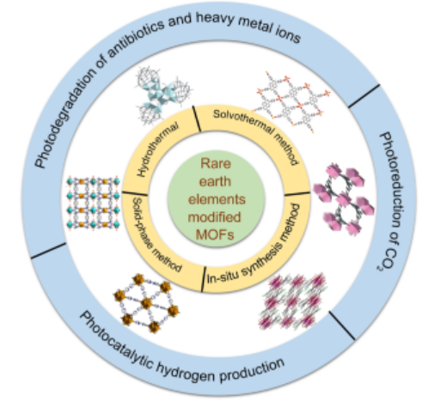
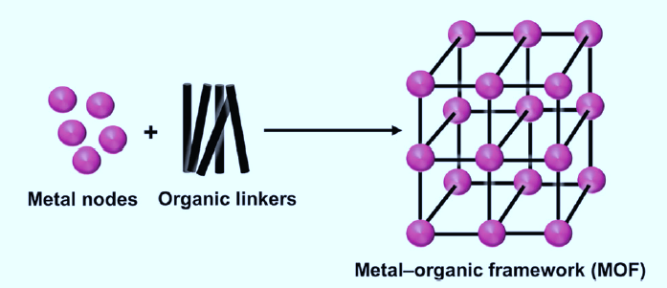
稀土改性的MOF 催化剂/ Rare earth-modified MOF catalyst
金属有机骨架材料(MOFs)因其优异的光学性质和物理化学性质而在光催化领域得到发展，包括环境修复、CO₂光还原、水分解等。用稀土元素修饰MOF可以拓宽吸收光谱，而其空4f轨道上的活性电子可以作为陷阱捕获光激发载流子，抑制电子-空穴对的复合，从而促进光催化活性。因此，稀土元素改性MOFs提供了一种实现其高价值利用的有吸引力的方法。
Metal organic framework materials (MOFs) have been developed in the field of photocatalysis due to their excellent optical and physicochemical properties, including environmental remediation, CO2 photoreduction, water splitting, etc. Modifying MOFs with rare earth elements can broaden the absorption spectrum, while the active electrons on their empty 4f orbitals can act as traps to capture photoexcited carriers, suppress electron hole pair recombination, and promote photocatalytic activity. Therefore, rare earth element modified MOFs provide an attractive method for achieving their high-value utilization.

Slide 32
稀土合金催化剂 / Rare earth alloy catalyst
各类稀土合金催化剂在能量转换领域的应用，为新一代稀土合金催化剂的设计与应用提供了重要参考。稀土元素在合金催化剂中的最新研究方向，主要聚焦于优化并最大化其在电催化反应（如 HER、OER、ORR、EOR）及热催化反应（如 AHR、NHR、CMR、ASR、SCR）中的应用效能。The applications of various rare-earth alloy catalysts in the field of energy conversion provide valuable references for the design and application of next-generation rare-earth alloy catalysts. The latest research directions of rare-earth elements in alloy catalysts mainly focus on optimizing and maximizing their application efficiency in electrocatalytic reactions (such as HER, OER, ORR, EOR) and thermocatalytic reactions (such as AHR, NHR, CMR, ASR, and SCR).
- Electrocatalytic Reactions 电催化反应
- Thermocatalytic Reactions 热催化反应
HER: 析氢反应 Hydrogen evolution reaction
OER: 析氧反应 Oxygen evolution reaction
ORR: 氧还原反应 Oxygen reduction reaction
EOR: 乙醇氧化反应 Ethanol oxidation reaction
AHR: 烯烃加氢反应 Alkene hydrogenation reaction
CMR: CO₂甲烷化反应 CO₂ methanation reaction
NHR: 硝基芳烃加氢反应 Nitroarene hydrogenation reaction
ASR: 氨合成反应 Ammonia synthesis reaction
SCR: 铃木耦合反应 Suzuki coupling reaction
Rare‐Earth Incorporated Alloy Catalysts: Synthesis, Properties, and Applications
Adv. Mater. 2021
Shuai Zhang，Sandra Elizabeth Saji ，Zongyou Yin，Hongbo Zhang，Yaping Du，Chun‐Hua Yan
https://doi.org/10.1002/adma.202005988

Slide 33
稀土合金催化剂 / Rare earth alloy catalyst
稀土合金代表了材料化学，催化和能量转化领域中最有活力和最有前途的研究主题。与不含稀土元素的合金相比，稀土合金不仅具有前者的所有优点，而且稀土合金在反应活性，选择性和稳定性等各个方面都表现出更好的催化性能。通过调整合成方法，可以精确设计稀土合金的成分元素和结构形状，直接影响表面原子的结构，从而获得优异的催化性能。Rare earth alloys represent the most dynamic and promising research topics in the fields of material chemistry, catalysis, and energy conversion. Compared with alloys without rare earth elements, rare earth alloys not only have all the advantages of the former, but also exhibit better catalytic performance in various aspects such as reaction activity, selectivity, and stability. By adjusting the synthesis method, the composition elements and structural shape of rare earth alloys can be precisely designed, directly affecting the structure of surface atoms, thereby achieving excellent catalytic performance.
稀土合金制备不容易，要采用特殊方法。常规方法产生分离的混合物。The preparation of rare earth alloys is not easy and requires special methods. Conventional methods produce separated mixtures.
Rare‐Earth Incorporated Alloy Catalysts: Synthesis, Properties, and Applications
Adv. Mater. 2021
Shuai Zhang，Sandra Elizabeth Saji ，Zongyou Yin，Hongbo Zhang，Yaping Du，Chun‐Hua Yan
https://doi.org/10.1002/adma.202005988

Slide 34
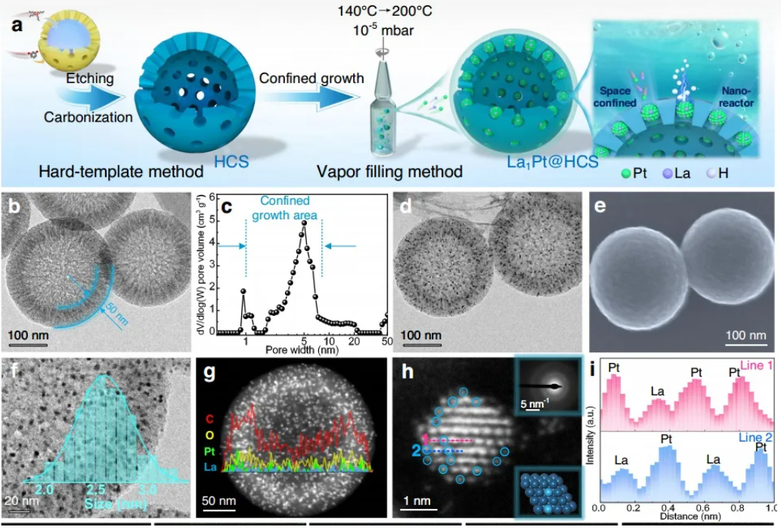
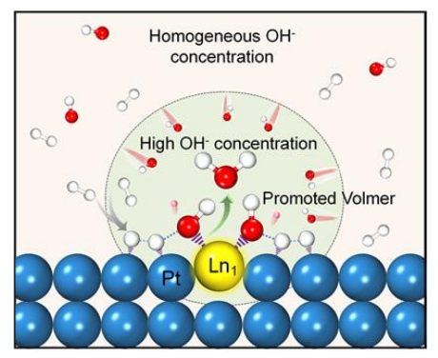
稀土合金催化剂PtLa1@HCS / Rare earth alloy catalyst PtLa1@HCS
电化学催化Electrocatalyst
亲氧稀土单原子嵌入铂纳米团簇用于高效氢氧化反应Oxygen‑philic rare‑earth single atoms embedded in platinum nanoclusters for efficient hydrogen oxidation reaction
Embedding oxophilic rare-earth single atom in platinum nanoclusters for efficient hydrogen electro-oxidation, Nature Communications,

Slide 35
PART 05 / 第五部分
总结与未来展望
Conclusion and Future Outlook
Notes:
最后，让我们对本次报告进行总结，并对稀土催化的未来发展进行展望。

Slide 36
总结 / Conclusion
不可替代的战略资源Irreplaceable Strategic Resource
技术驱动的创新前沿Technology-Driven Innovation Frontier
绿色发展的重要支撑Key Support for Green Development
稀土元素凭借其独特的电子结构和化学性质，在传统工业（如汽车、石化）和新兴能源领域（如氢能、CO₂转化）均扮演着不可替代的关键角色，是名副其实的“工业味精”。With their unique electronic structure and chemical properties, rare earth elements play an irreplaceable and pivotal role in both traditional industries (such as automotive and petrochemical) and emerging energy fields (such as hydrogen energy and CO₂ conversion), earning them the reputation of "industrial monosodium glutamate".
从单原子材料设计到催化机理的深入研究，稀土催化领域不断涌现新理论与新应用，是材料科学与催化化学交叉创新的前沿阵地。From single-atom material design to in-depth research on catalytic mechanisms, the field of rare earth catalysis continues to see the emergence of new theories and applications, serving as a frontier for interdisciplinary innovation between materials science and catalytic chemistry.
稀土催化技术在节能减排、资源循环利用等方面发挥着至关重要的作用，是实现“双碳”目标和推动社会绿色、可持续发展的核心支撑。Rare earth catalytic technology plays a vital role in energy conservation, emission reduction, and resource recycling, serving as a core pillar for achieving the "dual carbon" goals and promoting the green and sustainable development of society.
Notes:
总结来说，稀土催化的重要性体现在三个方面：首先，它是现代工业不可或缺的战略资源；其次，它是科技创新的持续动力，不断推动着催化科学的发展；最后，它更是我们实现绿色发展、迈向碳中和未来的重要支撑。

Slide 37
未来展望 / Future Outlook
未来研究方向 Research Directions
面临的挑战 Key Challenges
原子尺度精准设计Precise Design at the Atomic Scale
发展单原子、团簇催化剂，追求100%原子利用率与极致性能。Develop single-atom and cluster catalysts to pursue 100% atomic utilization and ultimate performance.
资源的可持续性 Resource Sustainability
探索高效利用与循环回收技术，缓解稀土资源供应压力。 Explore efficient utilization and recycling technologies to ease the supply pressure on rare earth resources.
多尺度理论模拟与AI辅助Multiscale Theoretical Simulation and AI Assistance
结合机器学习与高通量计算，加速新型催化剂的设计与筛选。Combine machine learning with high-throughput computing to accelerate the design and screening of new catalysts.
机理的深度理解 In-Depth Understanding of Mechanisms
深化对稀土在复杂催化体系中作用机理的微观认识。 Deepen the microscopic understanding of the mechanism of rare earths in complex catalytic systems.
温和条件下的高效催化Efficient Catalysis Under Mild Conditions
开发常温常压高效催化剂，显著降低工业应用的能耗与成本。Develop high-efficiency catalysts at ambient temperature and pressure to significantly reduce energy consumption and costs in industrial applications.
从实验室到工业的转化 Translation from Laboratory to Industry
解决成果转化的经济性与工程化难题，实现产业化落地。 Address the economic and engineering challenges of technology transfer to achieve industrial-scale implementation.
多功能与协同催化 Multifunctional and Synergistic Catalysis
设计多功能催化剂，实现复杂反应的一步完成，提升效率。 Design multifunctional catalysts to achieve one-step completion of complex reactions and improve efficiency.
Notes:
展望未来，稀土催化的研究将朝着更精准、更智能、更高效的方向发展。我们将致力于在原子尺度上设计催化剂，并利用人工智能加速研发进程。但同时，我们也面临着资源可持续性、机理理解和成果转化等挑战。克服这些挑战，将是未来稀土催化领域取得更大突破的关键。

Slide 38

Thanks
施宗波 博士
润和催化剂股份有限公司
地址：上海临港新片区宏祥北路83弄
邮箱: zongbo.shi@rezel.com.cn
手机:+86 15221060998

